Slide 1
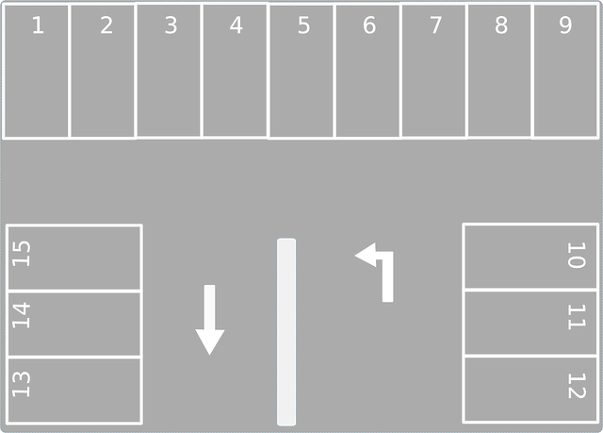
Team I-dle
Parking lot vacancy notification system
in SKKU

Slide 2
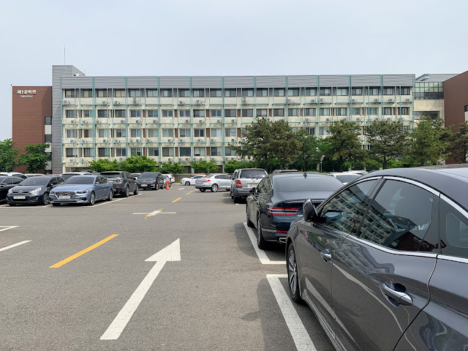

Motivation
So many cars..
So where is the vacant place?

Slide 3
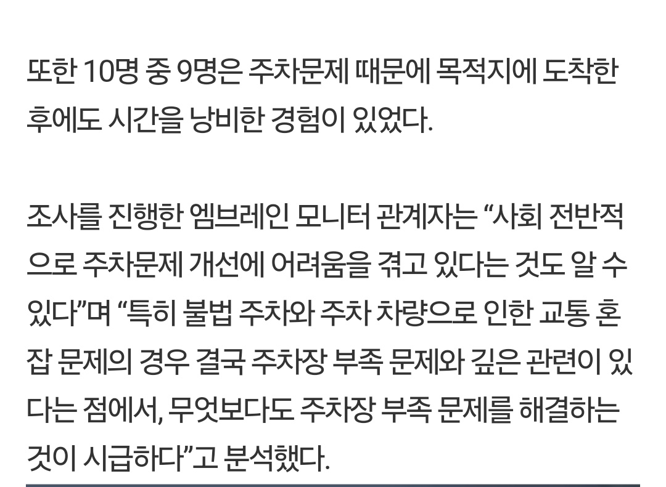
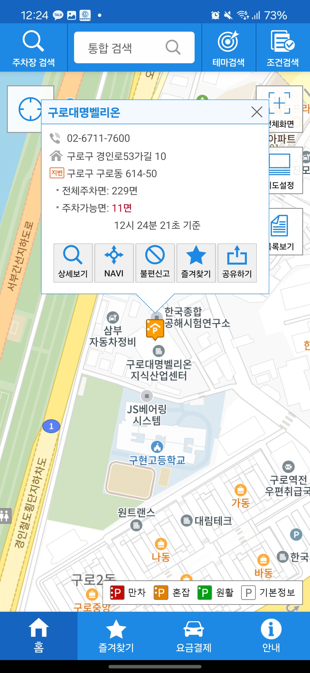

Motivation
“55% of drivers experience
parking-related stress,
and 9 out of 10 people lose time
because of parking.”
“Most people have experienced wasting time due to parking issues after arriving at their destination.”

Slide 4

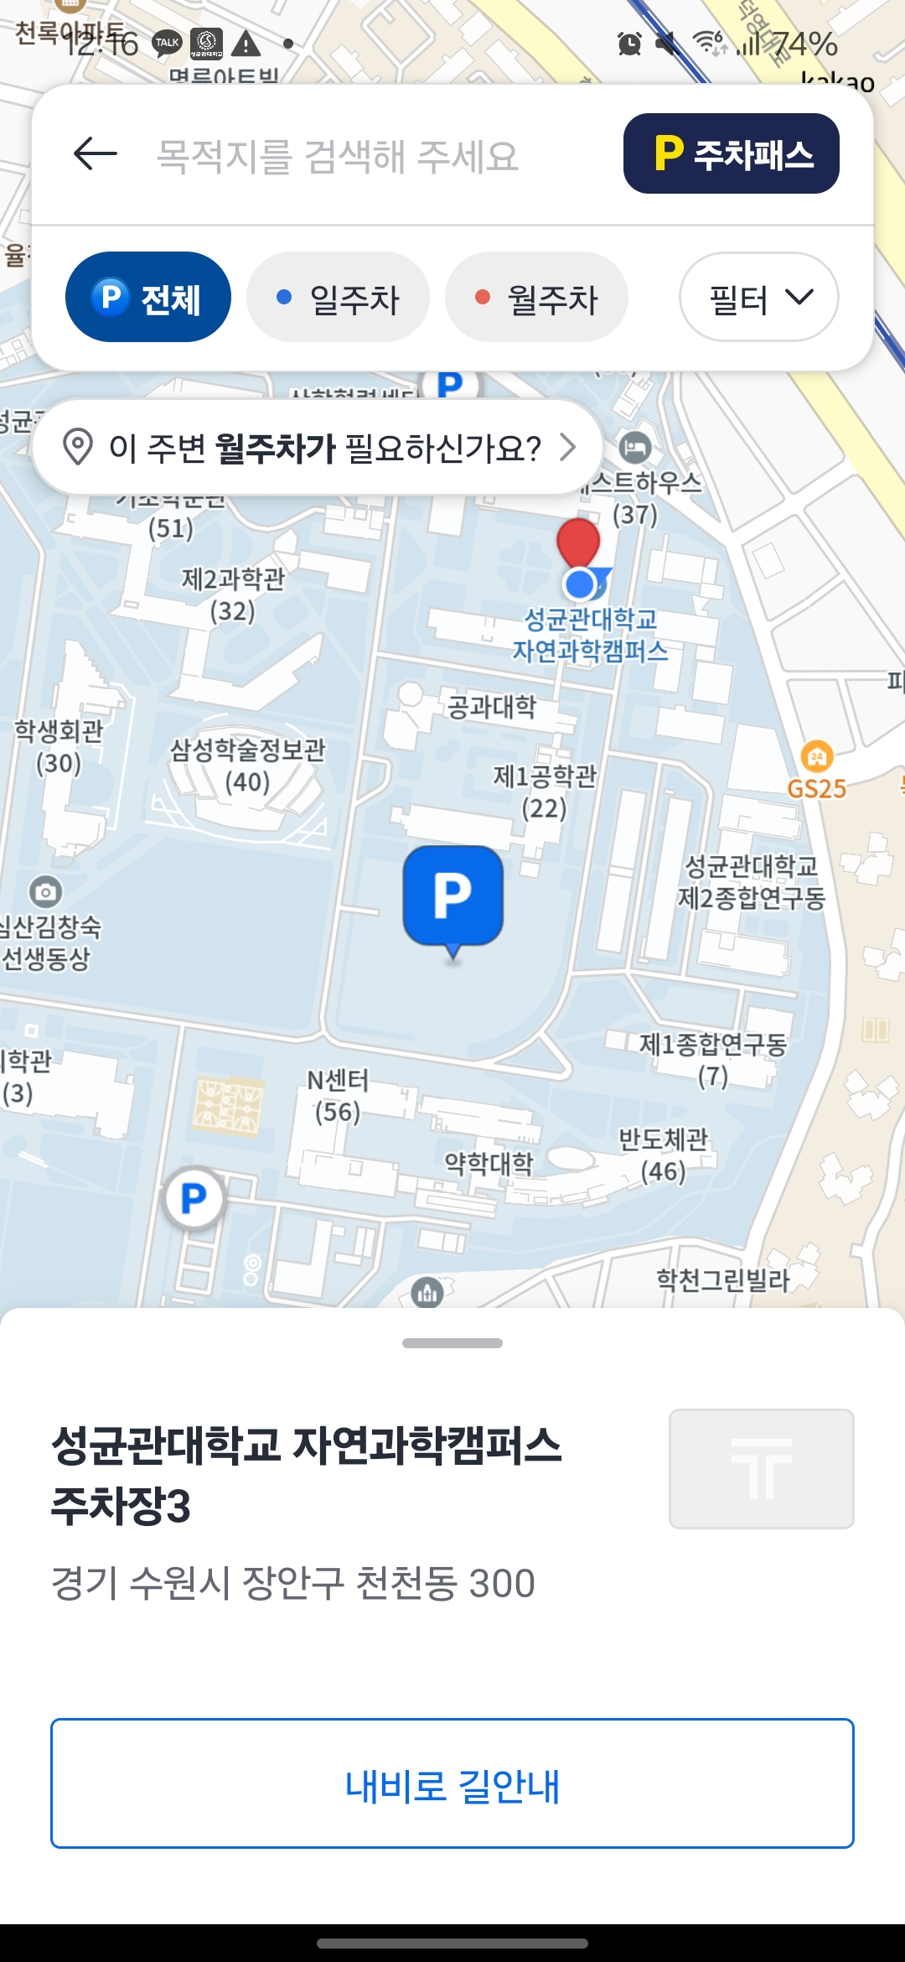
Our target
SKKU parking lot
Vacant space notification
Alarm App
알 수 없는 작성자 님의 이 사진에는 CC BY-NC 라이선스가 적용됩니다.

Slide 5
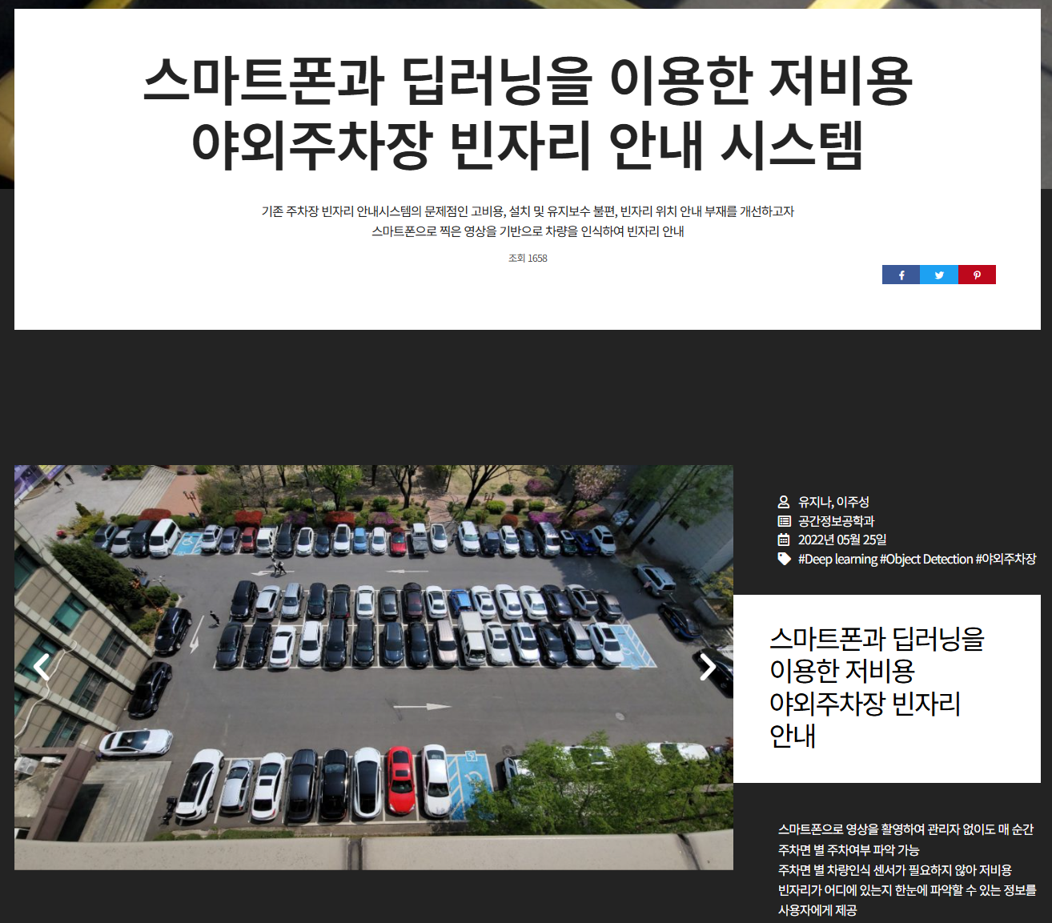
Related works
“A low-cost outdoor parking spot guidance system using smartphones and deep learning”
In SKKU,
+ Mobile App
+ multiple cameras
+ better algorithm
+ Additional functions

Slide 6

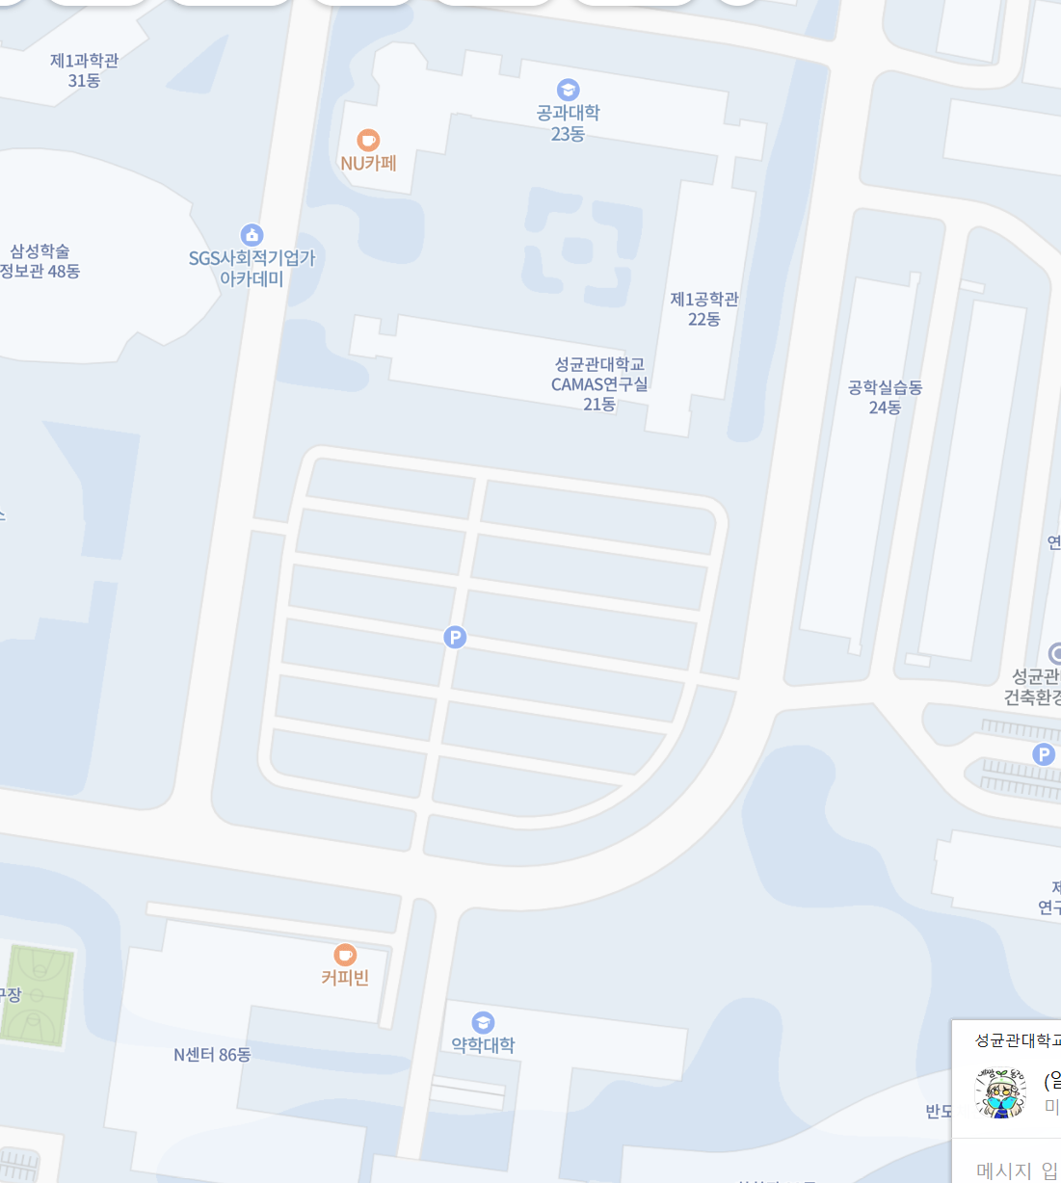


So how to?

Slide 7
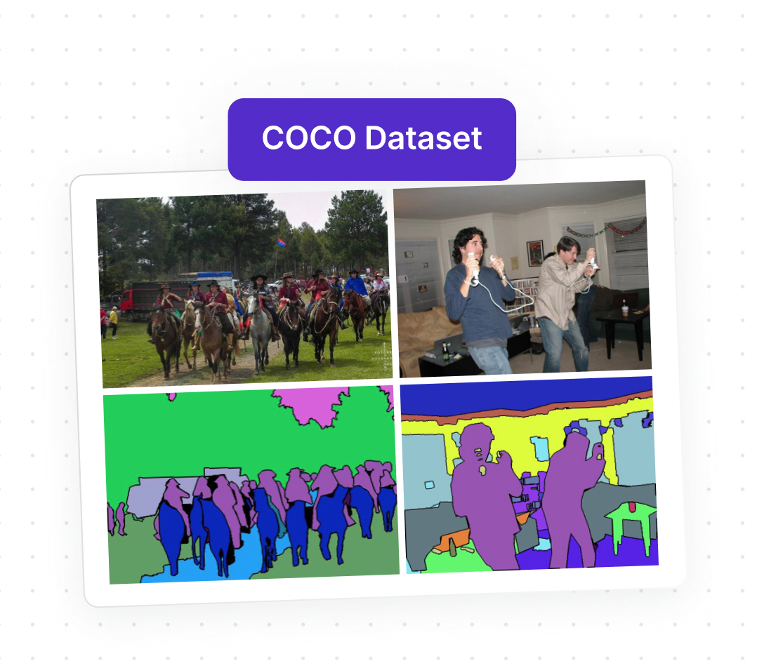
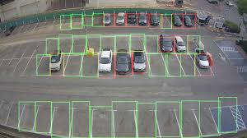


So how to?

